Slide 1
19CSE211 Computer Architecture & Organization
Design Rules

Slide 2
MIPS Design Principles
Simplicity favours regularity.
Smaller is faster
Good design demands good compromises.
Make the common case fast.

Slide 3
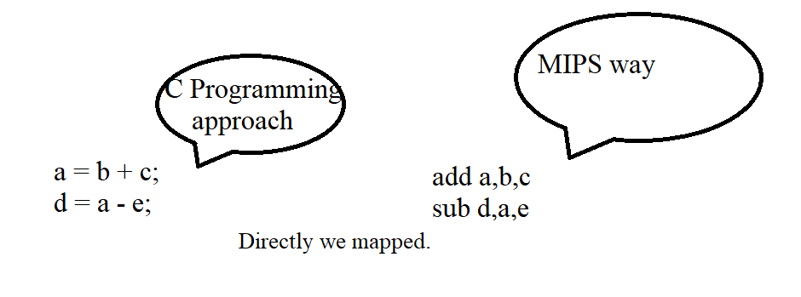
Design Rule 1 (Keep it simple(Referred as simplicity offers regularity)
a,b,c are register contents .
Rule 1 –It is all simple with MIPS.
fixed size instructions
small number of instruction formats
opcode always the first 6 bits

Slide 4
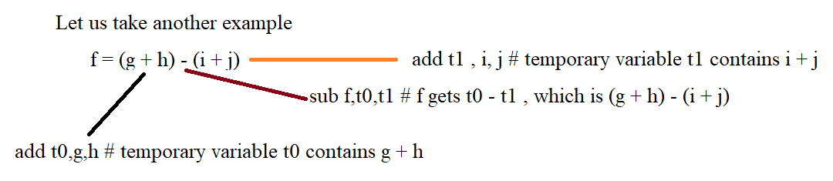
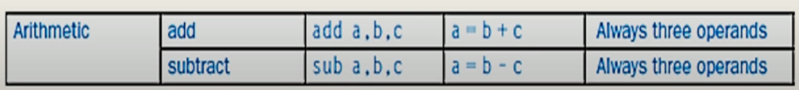
Design rule 1 contd….
2
3
1
So it is easy with MIPS . Simplicity rendered to perform operations as good as it is in high level languages is an added advantage.

Slide 5
Design Rule 2(Make it smaller – as it would be faster)
If more number of registers are there, it would need more clock cycle time.
- why ?
- simple. It will take electronic signals longer when they have to travel farther.
limited instruction set
limited number of registers in register file
limited number of addressing modes

Slide 6
Rule 3 – Make the common case fast
We can never avoid constants in the instruction .
Particularly when it comes to arithmetic instructions, constants remain inevitable.
Hence, use it as we used with immediate instructions as it would certainly be faster than it is getting loaded from memory.
Arithmetic operands from the register file (load-store machine)
Allow instructions to contain immediate operands

Slide 7
Rule 3 – Make the common case fast….Contd…
Problem statement : (Condition : Do not use ADDi)
Add constant 5 to register $S4
How to do this ??
LW $t1,offset($S2) # Here , $t1=5
ADD $S4,$S4,$t1 # $S4 = $S4 + $t1
Is this not complex ? Yes. It is.
So how do we sort this out ?
ADDI $S4,$S4,5 #$S4 = $S4 + 5;

Slide 8
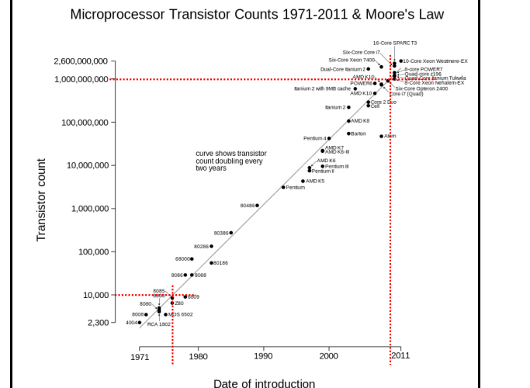
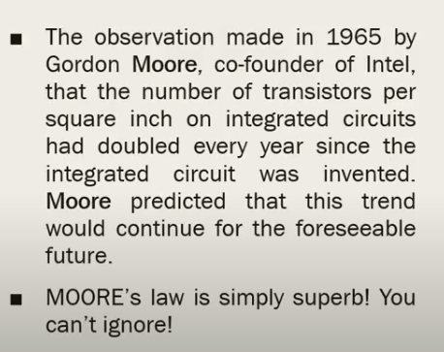
Good design

Slide 9
Rule 4 : We have to accept some compromises to get good design in place.
All MIPS instructions are of same size, ie, same instruction length .
32 bits long.
This has forces the designers to provide 3 different formats- I,J and R type to meet the requirements.
This is a compromise. Undoubtedly.

